Slide 1
Structured Query Language (SQL) & Indexing
-Unit 4

Slide 2
Overview of SQL
Structured Query Language or SQL is a standard Database language which is used to create, maintain and retrieve the data from relational databases.
Examples of databases are MySQL, Oracle, SQL Server, PostGre, etc. The recent ISO standard version of SQL is SQL:2019.
As the name suggests, it is used when we have structured data (in the form of tables).
All databases that are not relational (or do not use fixed structure tables to store data) and therefore do not use SQL, are called NoSQL databases. Examples of NoSQL are MongoDB, DynamoDB, Cassandra, etc.

Slide 3
SQL is used to perform operations on the records stored in the database, such as
updating records,
inserting records,
deleting records,
creating and
modifying database tables,
views, etc.
SQL is not case sensitive. But it is a recommended practice to use keywords (like SELECT, UPDATE, CREATE, etc) in capital letters and use user defined things (liked table name, column name, etc) in small letters.

Slide 4
Advantages of SQL
Faster Query Processing (High speed)–
Large amount of data is retrieved quickly and efficiently.
Operations like Insertion, deletion, manipulation of data is also done in almost no time.
No Coding Skills –
For data retrieval, large number of lines of code is not required.
All basic keywords such as SELECT, INSERT INTO, UPDATE, etc are used
Standardized Language –
Due to documentation and long establishment over years, it provides a uniform platform worldwide to all its users.

Slide 5
Portable –
It can be used in programs in PCs, server, laptops independent of any platform (Operating System, etc).
Also, it can be embedded with other applications as per need/requirement/use.
Interactive Language –
Easy to learn and understand, answers to complex queries can be received in seconds.
Multiple data view
Using the SQL language, the users can make different views of the database structure.

Slide 6
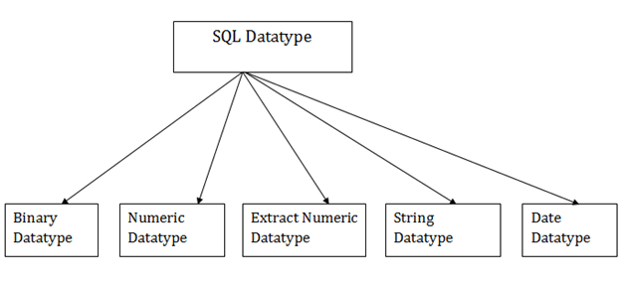
SQL Data types

Slide 7
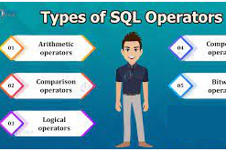
SQL Operators

Slide 8
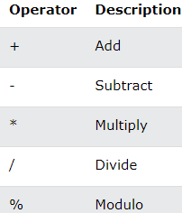
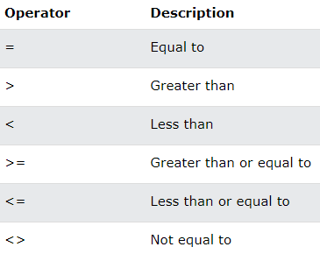
Arithmetic Operators
Comparison Operator

Slide 9
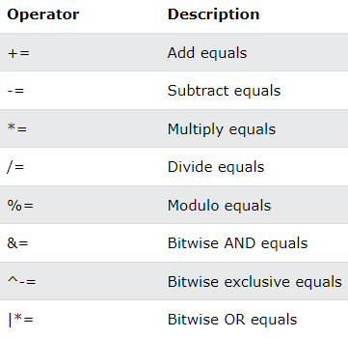
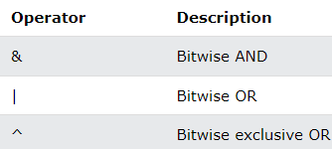
Compound Operators
Bitwise Operator

Slide 10
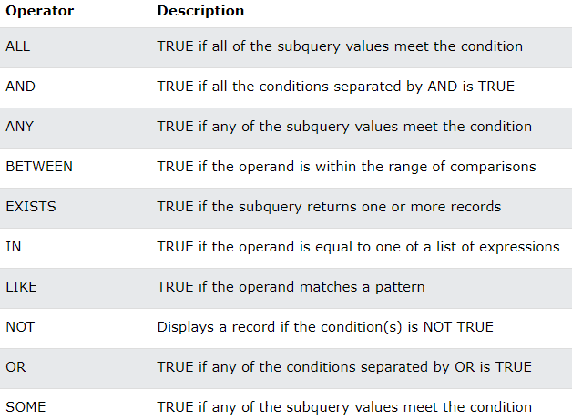
Logical Operators

Slide 11
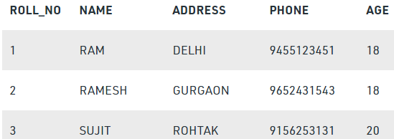
What is Relational Database?
Relational database means the data is stored as well as retrieved in the form of relations (tables).
Table 1 shows the relational database with only one relation called STUDENT,
which stores ROLL_NO, NAME, ADDRESS, PHONE and AGE of students.
STUDENT

Slide 12
Important terminologies that are used in terms of relation.
Attribute (field): Attributes are the properties that define a relation. e.g.; ROLL_NO, NAME etc.
Tuple: Each row in the relation is known as tuple.
Degree: The number of attributes in the relation is known as degree of the relation.
Ex.The STUDENT relation defined above has degree 5.
Cardinality: The number of tuples in a relation is known as cardinality. Ex.The STUDENT relation defined above has cardinality 3.
Column: Column represents the set of values for a particular attribute.
A query: It is an inquiry to the database for information.

Slide 13
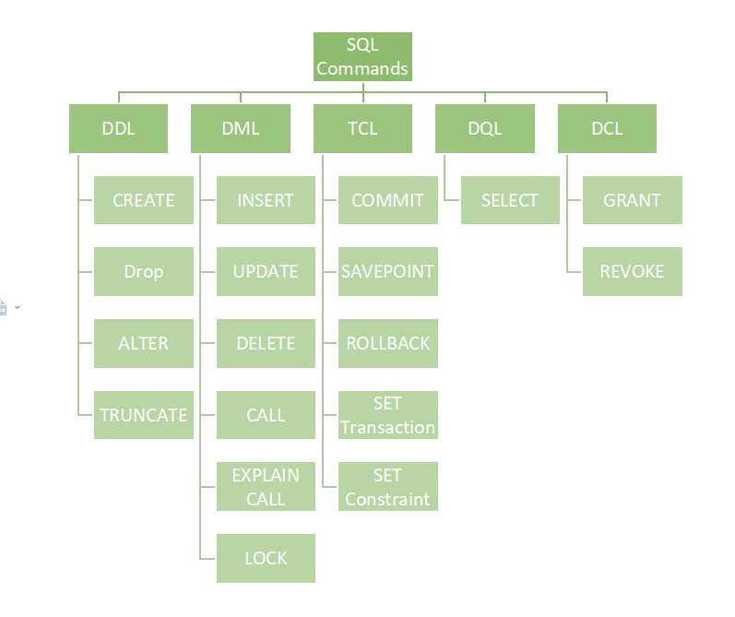
Classification of SQL commands
DDL (Data Definition Language)
DML (Data Manipulation Language)
DCL (Data Control Language)
DQL (Data Query Language)
Transactional control commands

Slide 14
DQL (Data Query Language):
It allows getting data from the database and imposing order upon it.
It includes the SELECT statement.
This command allows getting the data out of the database to perform operations with it.
List of DQL:
SELECT: It is used to retrieve data from the database.
It is also can be used with where clause to retrieve specific record.
Syntax: Select column from <table_name> where <condition>;
Ex. Select * from students where rno=5;

Slide 15
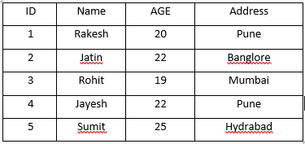
SELECT Command
The SELECT command shows the records of the specified table.
It also shows the particular record of a particular column by using the WHERE clause.
Select statement retrieves the data from database according to the constraints specifies alongside.
Syntax:
SELECT <Col1 , col2 , col3 … , col N> FROM <TABLE NAME>
Here, column_Name_1, column_Name_2, ….., column_Name_N are the names of those columns whose data we want to retrieve from the table.
If we want to retrieve the data from all the columns of the table, we have to use the following SELECT command:
SELECT * FROM table_name;
Example:
Select * from students;

Slide 16
USE OF DISTINCT
SQL does not treat a relation as a set; duplicate tuples can appear
To eliminate duplicate tuples in a query result, the keyword DISTINCT is used
For example, the result of Q11 may have duplicate SALARY values whereas Q11A does not have any duplicate values
Q11: SELECT SALARY FROM EMPLOYEE Q11A: SELECT DISTINCT SALARY FROM EMPLOYEE
Slide 8- 16
Notes:
16

Slide 17
USE OF DISTINCT
SQL does not treat a relation as a set; duplicate tuples can appear
To eliminate duplicate tuples in a query result, the keyword DISTINCT is used
For example, the result of Q11 may have duplicate SALARY values whereas Q11A does not have any duplicate values
Q11: SELECT SALARY FROM EMPLOYEE Q11A: SELECT DISTINCT SALARY FROM EMPLOYEE
Slide 8- 17
Notes:
17

Slide 18
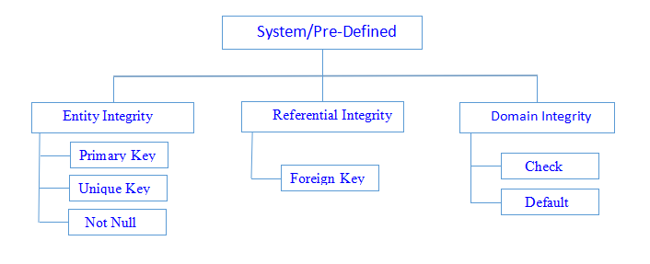
Classification of constraints

Slide 19
SQL constraints
Integrity constraints are a set of rules. It is used to maintain the quality of information.
Integrity constraints ensure that changes made to the database by authorized users do not result in a loss of data consistency.
Thus, integrity constraints guard against accidental damage to the database.
Constraints can be specified when a table is created with the CREATE TABLE statement.
you can use the ALTER TABLE statement to create constraints even after the table is created.
Constraints can be defined in two ways
column-level definition The constraints can be specified immediately after the column definition.
table-level definition The constraints can be specified after all the columns are defined.

Slide 20
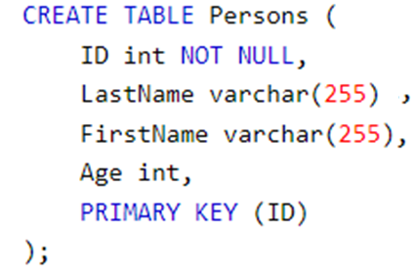
NOT NULL Constraints
The NOT NULL constraint in a column means that the column cannot store NULL values.
That is, you will be not allowed to insert a new row in the table without specifying any value to this field.

Slide 21

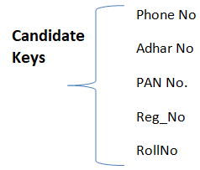

Slide 22
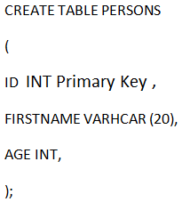
Primary key constraints
Column
This constraint defines a column or combination of columns which uniquely identifies each row in the table.
Primary keys must contain UNIQUE values, and cannot contain NULL values.
A table can have only ONE primary key; and in the table, this primary key can consist of single or multiple columns (fields).
Syntax:
It creates a PRIMARY KEY on the "ID" column when the "Persons" table is created:
Column Level
Table level

Slide 23
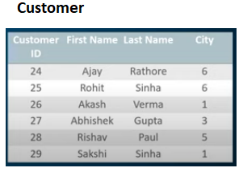
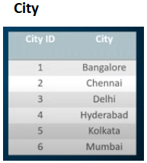
Foreign Key constraints
The FOREIGN KEY constraint is used to prevent actions that would destroy links between tables.
A FOREIGN KEY is a field (or collection of fields) in one table, that refers to the PRIMARY KEY in another table.
The table with the foreign key is called the child table, and the table with the primary key is called the referenced or parent table.

Slide 24
Syntax:
SQL FOREIGN KEY on CREATE TABLE
CREATE TABLE customer (
customerID int NOT NULL,
FirstName varchar(20),
LastName varchar(20)
City int,
PRIMARY KEY (customerID),
FOREIGN KEY (city) REFERENCES City(CityID)
);

Slide 25
Unique constraints
The UNIQUE constraint ensures that all values in a column are different.
Both the UNIQUE and PRIMARY KEY constraints provide a guarantee for uniqueness for a column or set of columns.
A PRIMARY KEY constraint automatically has a UNIQUE constraint.
However, you can have many UNIQUE constraints per table, but only one PRIMARY KEY constraint per table.

Slide 26
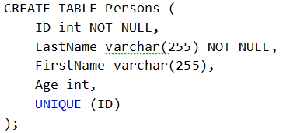
SQL UNIQUE Constraint on CREATE TABLE
The following SQL creates a UNIQUE constraint on the "ID" column when the "Persons" table is created:

Slide 27
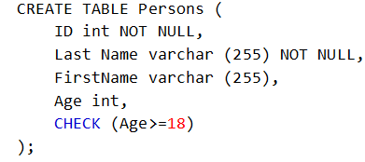
Check constraints
The CHECK constraint is used to limit the value range that can be placed in a column.
If you define a CHECK constraint on a column it will allow only certain values for this column.
SQL CHECK on CREATE TABLE

Slide 28
Default constraints
The DEFAULT constraint is used to set a default value for a column.
The default value will be added to all new records, if no other value is specified.
SQL DEFAULT on CREATE TABLE
To set a DEFAULT value for the “Location” column when the “Venue” table is created –
CREATE TABLE Venue ( ID int NOT NULL, Name varchar(255), Age int, Location varchar(255) DEFAULT ‘Mumbai');

Slide 29
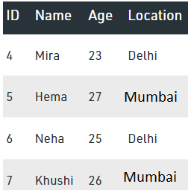
INSERT INTO Venue VALUES (4, 'Mira', 23, 'Delhi');
INSERT INTO Venue VALUES (5, 'Hema', 27);
INSERT INTO Venue VALUES (6, 'Neha', 25, 'Delhi');
INSERT INTO Venue VALUES (7, 'Khushi', 26);
select * from Venue;

Slide 30
DDL COMMANDS

Slide 31
DDL (Data Definition Language):
It is used to define the structure of the database .
DDL actually consists of the SQL commands that can be used to define the database schema. (A schema is a collection of database objects like tables, triggers, stored procedures, etc. )
Data Definition Language, DDL, is the part of SQL that allows a database user to create and restructure database objects, such as the creation or the deletion of a table.
DDL commands :
CREATE
ALTER TABLE
DROP TABLE
TRUNCATE TABLE
RENAME TABLE
CREATE INDEX
ALTER INDEX
DROP INDEX
CREATE VIEW
DROP VIEW

Slide 32

CREATE, SHOW & DROP DATABASE
The SQL CREATE DATABASE statement is used to create a new SQL database.
Syntax:
Example
If you want to create a new database <college>,
Posgres> CREATE DATABASE college;
Once a database is created, you can check it in the list:
Postgres> \list;
DROP DATABASE
The SQL DROP DATABASE statement is used to drop an existing database in SQL schema.
Syntax: DROP DATABASE DatabaseName;
Example:
SQL> DROP DATABASE college;

Slide 33
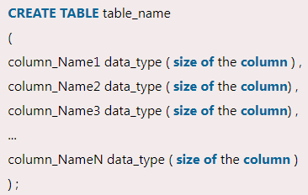
CREATE Table
Creating a basic table involves naming the table and defining its columns and each column's data type.
Syntax :
Note:
The data type of the columns may vary from one database to another.
For example, NUMBER is supported in Oracle database for integer value whereas INT is supported in MySQL.

Slide 34
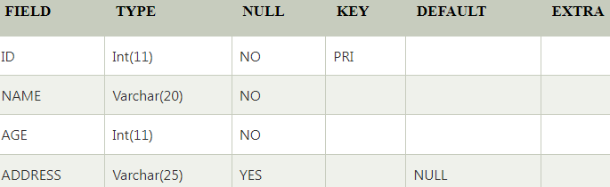
Example:
SQL> CREATE TABLE STUDENTS (
ID INT NOT NULL,
NAME VARCHAR (20) NOT NULL,
AGE INT NOT NULL,
ADDRESS VARCHAR (25),
PRIMARY KEY (ID)
);
You can see the structure of your table by using disc command.
Example: Postgres> \d STUDENTS;

Slide 35
DROP , TRUNCATE table command
DROP:
It is used to delete a table definition and all data from a table.
This is very important to know that once a table is deleted all the information available in the table is lost forever, so we have to be very careful when using this command.
Syntax: DROP TABLE <table_name>;
Truncate:
It is used to delete all the rows from the table and free the containing space.
Syntax: TRUNCATE TABLE <table_name>;

Slide 36
Alter table command
syntax:
To add new column:
ALTER TABLE table_name ADD column_name datatype;
To delete existing column:
ALTER TABLE table_name DROP COLUMN column_name;
To change column data type:
ALTER TABLE table_name ALTER COLUMN column_name TYPE datatype;
ALTER TABLE to ADD PRIMARY KEY constraint to a table
ALTER TABLE table_name ADD CONSTRAINT MyPrimaryKey PRIMARY KEY (column_name);

Slide 37
AGGRATION FUNCTIONS

Slide 38
AGGRATION FUNCTIONS:
Aggregation functions are used to perform mathematical operations on data values of a relation.
take a collection (a set or multiset) of values as input and return a single value.
Some of the common aggregation functions used in SQL are:
Average: avg
Minimum: min
Maximum: max
Total: sum
Count: count

Slide 39
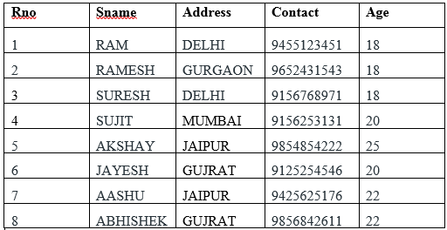
Example Table : “Student”

Slide 40
Count:
Query: SELECT COUNT (PHONE) FROM STUDENT;
Output: 8
SUM:
Query: SELECT SUM (AGE) FROM STUDENT;
163
AVG:
Query: SELECT AVG (AGE) FROM STUDENT;
20.37
MAX:
Query: SELECT MAX (AGE) FROM STUDENT;
25
MIN:
Query: SELECT MIN (AGE) FROM STUDENT;
18

Slide 41
Examples
1. Consider following relational tables:
Student (S_ID, Name, Dept_name)
Course ( course_ID, c_name, Dept_name)
Trainer (ID, name, dept_name)
Dept (Dept_ID, dept_name)
Solve above relation using DDL statements with primary key and Foreign key.

Slide 42
NULL Value
A field with a NULL value is a field with no value.
If a field in a table is optional, it is possible to insert a new record or update a record without adding a value to this field.
Then, the field will be saved with a NULL value.
It is not possible to test for NULL values with comparison operators, such as =, <, or <>.
We will have to use the IS NULL and IS NOT NULL operators instead.

Slide 43
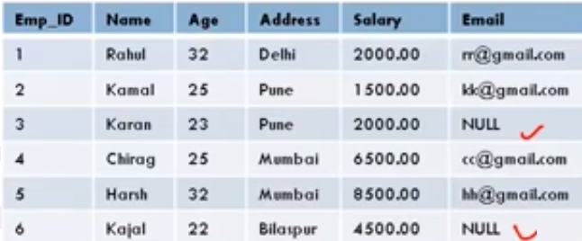

Slide 44
DML COMMANDS

Slide 45
DML(Data Manipulation Language)
Data Manipulation Language, DML, is the part of SQL used to manipulate data within objects of a relational database.
There are three basic DML commands:
INSERT
UPDATE
DELETE

Slide 46
Data Manipulation commands
A DML is a language that enables users to access or manipulate data as organized by the appropriate data model.
The types of access are:
Retrieval of information stored in the database
Insertion of new information into the database
Deletion of information from the database
Modification of information stored in the database

Slide 47
INSERT Command
Insert statement is used to insert data into database tables.
Syntax:
INSERT INTO <TABLE NAME> ( <COLUMNS TO INSERT> ) VALUES
( <VALUES TO INSERT> )
OR
INSERT INTO <TABLE NAME> VALUES
( <VALUES TO INSERT> )

Slide 48
Insert into students (ID, NAME, AGE, ADDRESS)values (1,’Rakesh’,20,’Pune’);
Or
Insert into students values (1,’Rakesh’,20,’Pune’);
Output:

Slide 49

UPDATE command
The SQL commands (UPDATE and DELETE) are used to modify the data that is already in the database.
`The SQL DELETE command uses a WHERE clause.
SQL UPDATE statement is used to change the data of the records held by tables.
Which rows is to be update, it is decided by a condition. To specify condition, we use WHERE clause.
Syntax: UPDATE table_name SET [column_name1= value1,... column_nameN = valueN] [WHERE condition]

Slide 50
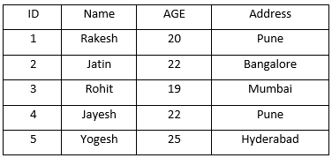
Example:
UPDATE students
SET Name = ’Yogesh'
WHERE Student_Id = ’5’

Slide 51
DELETE command
DELETE:
The DELETE statement is used to delete rows from a table.
If you want to remove a specific row from a table you should use WHERE condition.
Syntax: DELETE FROM table_name [WHERE condition];
OR
DELETE FROM table_name;

Slide 52
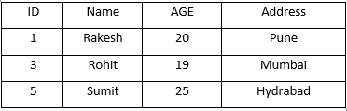
Example:
Delete * from students;
DELETE FROM students where age=“22”;

Slide 53
Complex Retrieval Queries using Group By

Slide 54
GROUP BY and HAVING Clause
The GROUP BY clause is a SQL command that is used to group rows that have the same values.
The GROUP BY clause is used in the SELECT statement.
Optionally it is used in conjunction with aggregate functions to produce summary reports from the database.
That’s what it does, summarizing data from the database.
The queries that contain the GROUP BY clause are called grouped queries and only return a single row for every grouped item.

Slide 55
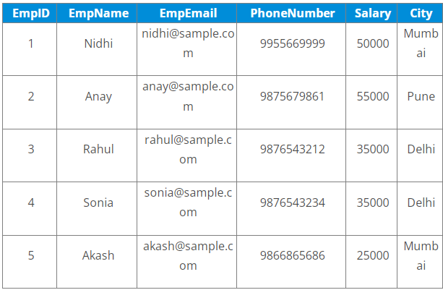
Examples:
Use GROUP BY on single column
GROUP BY on multiple columns
Use GROUP BY with ORDER BY
GROUP BY with HAVING clause
Use GROUP BY with JOINS

Slide 56
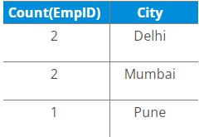
GROUP BY on single column
Example:
Find no. of employees per city.
Query:
SELECT COUNT(EmpID), City
FROM Employees
GROUP BY City;

Slide 57
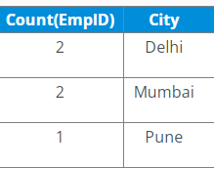
GROUP BY with ORDER BY
When we use the SQL GROUP BY statement with the ORDER BY clause, the values get sorted either in ascending or descending order.
Example:
Write a query to retrieve the number of employees in each city, sorted in descending order.
SELECT COUNT(EmpID), City
FROM Employees
GROUP BY City
ORDER BY COUNT(EmpID) DESC;

Slide 58
GROUP BY with HAVING clause
The SQL GROUP BY statement is used with ‘HAVING’ clause to mention conditions on groups.
Also, since we cannot use the aggregate functions with the WHERE clause, we have to use the ‘HAVING’ clause to use the aggregate functions with GROUP BY.
Example:
Write a query to retrieve the number of employees in each city, having salary > 15000
SELECT COUNT(EmpID), City
FROM Employees
GROUP BY City
HAVING SALARY > 15000;
(Since all are records in the Employee table have a salary > 15000,
we will see the following table as output)

Slide 59
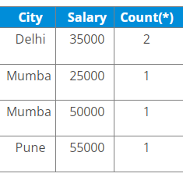
GROUP BY on multiple columns
Example:
Write a query to retrieve the number of employees having different salaries in each city.
SELECT City, Salary, Count(*)
FROM Employees
GROUP BY City, Salary;

Slide 60
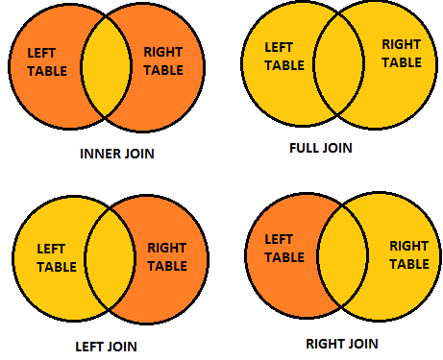
JOIN

Slide 61
SQL Join statement is used to combine data or rows from two or more tables based on a common field between them.
Different types of Joins are as follows:
INNER JOIN
LEFT JOIN
RIGHT JOIN
FULL JOIN

Slide 62
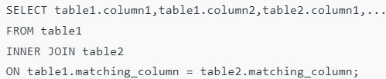

INNER JOIN
Returns records that have matching values in both tables.
We can also write JOIN instead of INNER JOIN. JOIN is same as INNER JOIN.
This keyword will create the result-set by combining all rows from both the tables where the condition satisfies
i.e value of the common field will be the same.
Syntax:

Slide 63
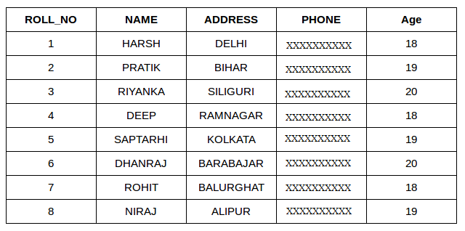
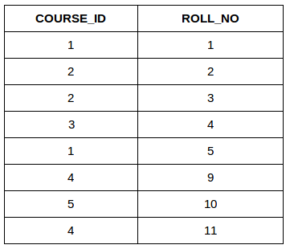
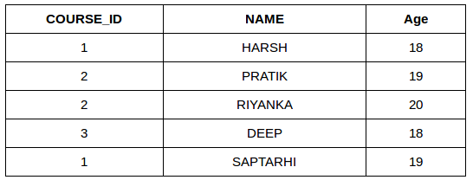
Student Course
SELECT Course.COURSE_ID, Student.NAME, Student.AGE FROM Student
INNER JOIN Course
ON Student.ROLL_NO = Course.ROLL_NO;

Slide 64
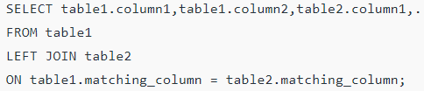
LEFT JOIN
This join returns all the rows of the table on the left side of the join and matches rows for the table on the right side of the join.
For the rows for which there is no matching row on the right side, the result-set will contain null.
LEFT JOIN is also known as LEFT OUTER JOIN.
Syntax:

Slide 65
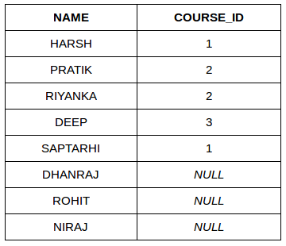
Example
SELECT Student.NAME,Course.COURSE_ID FROM Student
LEFT JOIN Course
ON Course.ROLL_NO = Student.ROLL_NO;

Slide 66
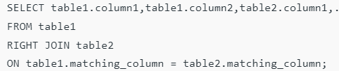
RIGHT JOIN
This join returns all the rows of the table on the right side of the join and matching rows for the table on the left side of the join.
For the rows for which there is no matching row on the left side, the result-set will contain null.
RIGHT JOIN is also known as RIGHT OUTER JOIN.
Syntax:

Slide 67
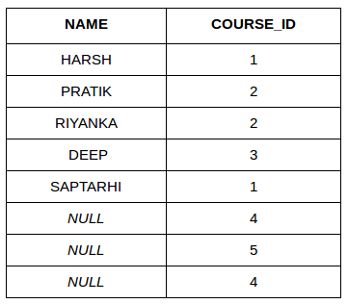
Example:
SELECT Student.NAME, Course.COURSE_ID
FROM Student
RIGHT JOIN Course
ON Course.ROLL_NO = Student.ROLL_NO;

Slide 68
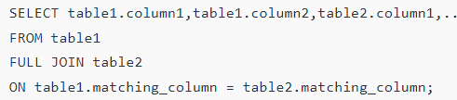
FULL JOIN
FULL JOIN creates the result-set by combining results of both LEFT JOIN and RIGHT JOIN.
The result-set will contain all the rows from both tables.
For the rows for which there is no matching, the result-set will contain NULL values.
SELECT table1

Slide 69
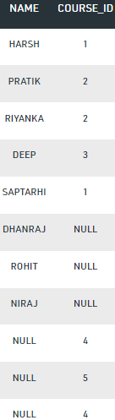
Example:
SELECT Student.NAME, Course.COURSE_ID
FROM Student
FULL JOIN Course
ON Course.ROLL_NO = Student.ROLL_NO;

Slide 70
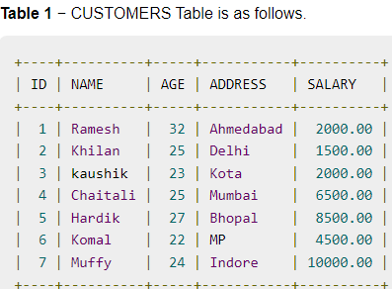
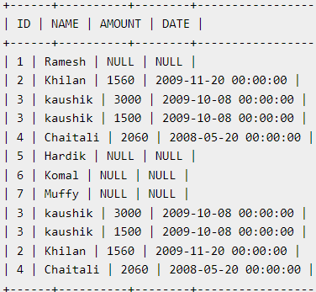
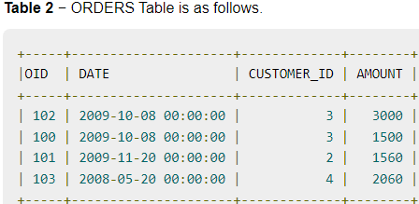
Example 2: full join

Slide 71
Logical Operators

Slide 72
LIKE condition
LIKE condition is used to perform pattern matching to find the correct result.
It is used in SELECT, INSERT, UPDATE and DELETE statement with the combination of WHERE clause.
Syntax:
expression LIKE pattern [ ESCAPE 'escape_character' ]
Parameters
expression: It specifies a column or field.
pattern: It is a character expression that contains pattern matching.
escape_character: It is optional. It allows you to test for literal instances of a wildcard character such as % or _. If you do not provide the escape_character, MySQL assumes that "\" is the escape_character.

Slide 73
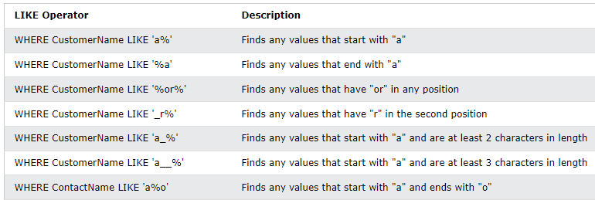
Different LIKE operators with '%' and '_' wildcards:

Slide 74
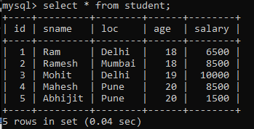
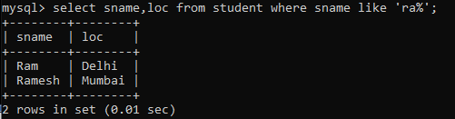
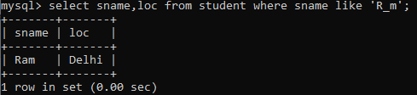
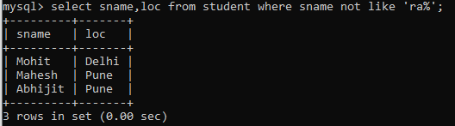
Examples
1) Using % (percent) Wildcard:
2) Using _ (Underscore) Wildcard:
3) using not like:

Slide 75
IN Condition
The IN operator allows you to specify multiple values in a WHERE clause.
The IN operator is a shorthand for multiple OR conditions.
Syntax
SELECT column_name(s) FROM table_name WHERE column_name IN (value1, value2, ...);
OR
SELECT column_name(s) FROM table_name WHERE column_name IN (SELECT STATEMENT);

Slide 76
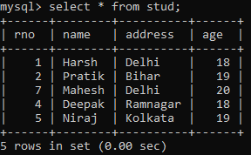
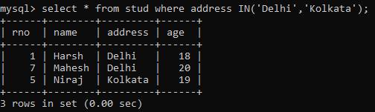


Examples

Slide 77
AND, OR and NOT Operators
The WHERE clause can be combined with AND, OR, and NOT operators.
The AND and OR operators are used to filter records based on more than one condition:
The AND operator displays a record if all the conditions separated by AND are TRUE.
The OR operator displays a record if any of the conditions separated by OR is TRUE.
The NOT operator displays a record if the condition(s) is NOT TRUE.

Slide 78





Slide 79




Slide 80

BETWEEN Operator
The BETWEEN operator selects values within a given range. The values can be numbers, text, or dates.
The BETWEEN operator is inclusive: begin and end values are included.
Syntax
SELECT column_name(s) FROM table_name WHERE column_name BETWEEN value1 AND value2;

Slide 81
Nested Queries in SQL

Slide 82
Subqueries
Subqueries can be used with the SELECT, INSERT, UPDATE, and DELETE statements along with the operators like =, <, >, >=, <=, IN, BETWEEN, etc.
There are a few rules that subqueries must follow −
Subqueries must be enclosed within parentheses.
A subquery can have only one column in the SELECT clause, unless multiple columns are in the main query for the subquery to compare its selected columns.
An ORDER BY command cannot be used in a subquery, although the main query can use an ORDER BY.
Subqueries that return more than one row can only be used with multiple value operators such as the IN operator.
The BETWEEN operator cannot be used with a subquery. However, the BETWEEN operator can be used within the subquery.

Slide 83


Nested Queries
In nested queries, a query is written inside a query. The result of inner query is used in execution of outer query.
Here we use STUDENT & city tables for understanding nested queries.

Slide 84


Subqueries with the SELECT Statement
Retrieve id and city name of all students those age is greater than 20.

Slide 85


Subquery with delete statement
To delete record from employees whose works in ‘IT’ Department.
Delete from employee where dept_id in(select department_id from department where department_name=‘IT’;

Slide 86



Example 2:

Slide 87


Subqueries with the UPDATE Statement
The subquery can be used in conjunction with the UPDATE statement.
Either single or multiple columns in a table can be updated when using a subquery with the UPDATE statement.
Syntax:

Slide 88
Example
Consider the following employee database.
Employee(emp_name, street,city,date_of_joining)
Works(emp_name,company_name,salary)
Company(company_name,city)
Manages(emp_name,manager_name)
Write SQL queries for following:
Modify the database so that ‘Deepa’lives in ‘Pune’;
Give all employees of ‘Aarya corporation’ a 10% rise in salary.
Display all employees who joined in the month of ‘March’;
Find all employees who earn more than average salary of all employees of their company.

